Slide 1


BUILD A RESUME AI ASSISTANT WITH OPENAI, GEMINI & PYDANTIC

Slide 2

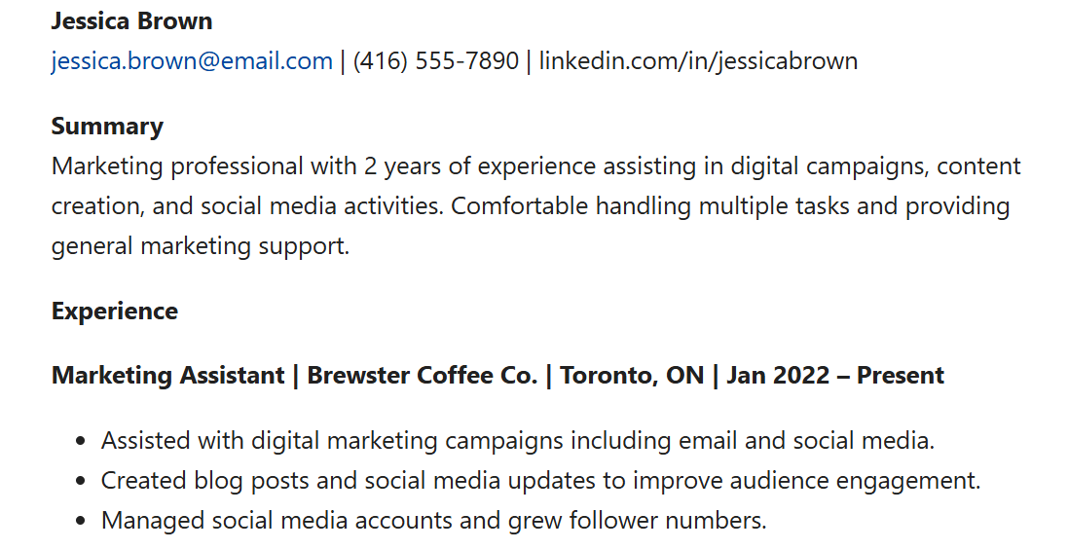



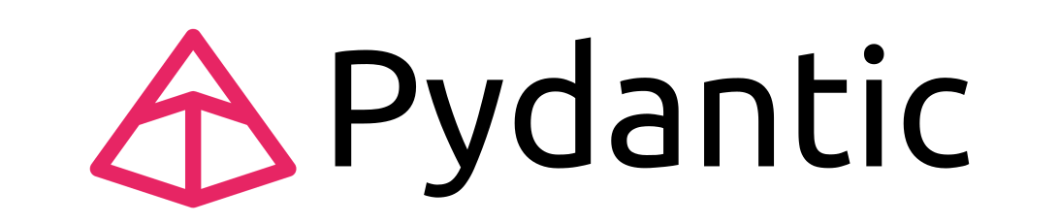
Project Overview
In this project, we'll build a "Resume AI Assistant" which uses the power of LLMs like OpenAI's GPT, Google's Gemini, and Pydantic to help job seekers tailor their resumes and generate custom cover letters for specific job applications.
Model Output
Old Resume
Gaps/Mismatch between resume & Job Description
Potential Strength
Match % Score
New Resume with gaps addressed
New tailored Cover Letter
OpenAI API
© All rights reserved for Dr. Ryan Ahmed @Stemplicity Inc.
Target Job Description

Slide 3
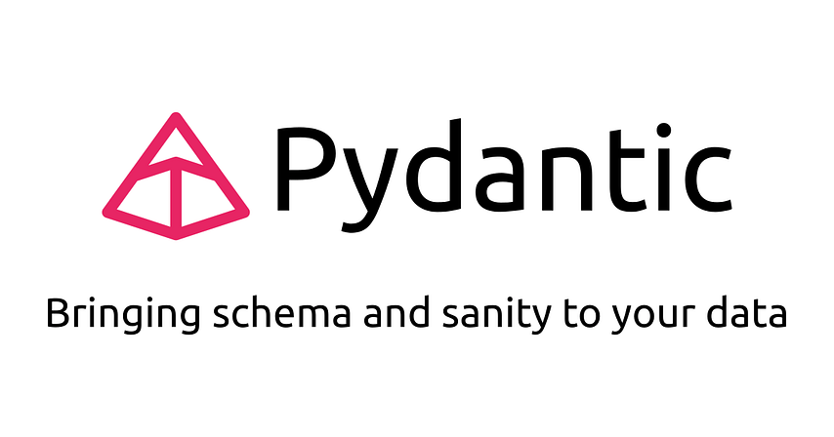
Pydantic 101
Pydantic is a Python library used to validate and parse data using Python type hints. It ensures that the data you get is clean, well-structured, and follows the rules you set.
How it works:
You define a data structure using a class
Pydantic ensures the data is correct (types, required fields, etc.)
It even converts data automatically if possible (e.g., turns strings into numbers or dates)
© All rights reserved for Dr. Ryan Ahmed @Stemplicity Inc.

Slide 4

Key Learning Outcomes
Master Pydantic library for output validation
Learn how to generate parsed structured output from OpenAI with Pydantic
Learn how to develop a text change tracker using OpenAI
Build a powerful AI resume editor that can identify gaps between resume and the job description and tailor the resume and cover letter.
© All rights reserved for Dr. Ryan Ahmed @Stemplicity Inc.

Slide 5

Summary
Pydantic is a powerful library that can perform data validation and output parsing and ensure consistent, well-structured, and robust outputs.
Text change tracking feature can be implemented using a proper prompt.
A powerful application for resume enhancement can be developed in one day with the power of LLMs such as gpt-4.o and Gemini.
© All rights reserved for Dr. Ryan Ahmed @Stemplicity Inc.

Slide 6
Thank you!

